Slide 1
Artificial Intelligence @ AWS
<your name>
Oct, 2018
© 2017, Amazon Web Services, Inc. or its Affiliates. All rights reserved.

Slide 2
Artificial Intelligence, Machine Learning, Deep Learning, Data Science #buzZZzzzWords… ?!

Slide 3
ARTIFICIAL INTELLIGENCE
MACHINE LEARNING
DEEP LEARNING

Slide 4
Artificial Intelligence
“The science and engineering of making intelligent machines”
(John McCarthy - ~1950s)

Slide 5




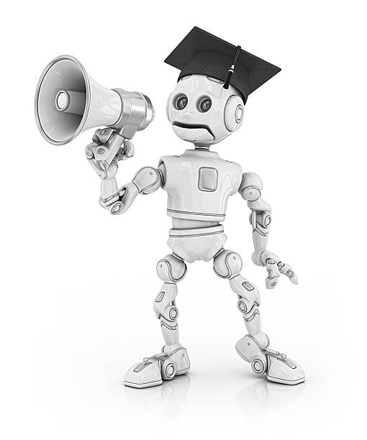




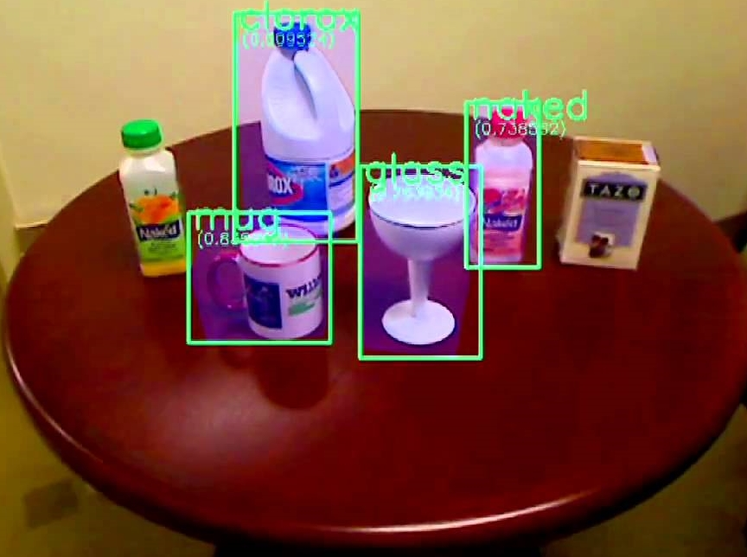
Artificial Intelligence
Weak AI
Strong AI (AGI)
I like artificial intelligence
Lubię sztuczną inteligencję
Imgs. Copyrighted by: TriStar pictures; Warner Bros; 20th Cetury Fox; NBC Universal; Metro-Goldwin-Mayer

Slide 6
Machine Learning
“Machine learning is a field of artificial intelligence that uses statistical techniques to give computer systems the ability to "learn" (e.g., progressively improve performance on a specific task) from data, without being explicitly programmed”
(Arthur Samuel - 1959)

Slide 7
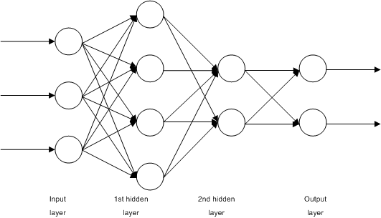
Deep Learning
Deep learning is part of a broader family of machine learning methods based on learning data representations, as opposed to task-specific algorithms.

Slide 8
Deep Learning
Classification
Sentiment Analysis
Facial Recognition
Forecasting
Object detection
Autonomous Cars
Recommendation systems
Translation
Fraud detection
Speech to Text/Text to Speech
Playing Video Games
Text classification
Image Segmentation

Slide 9
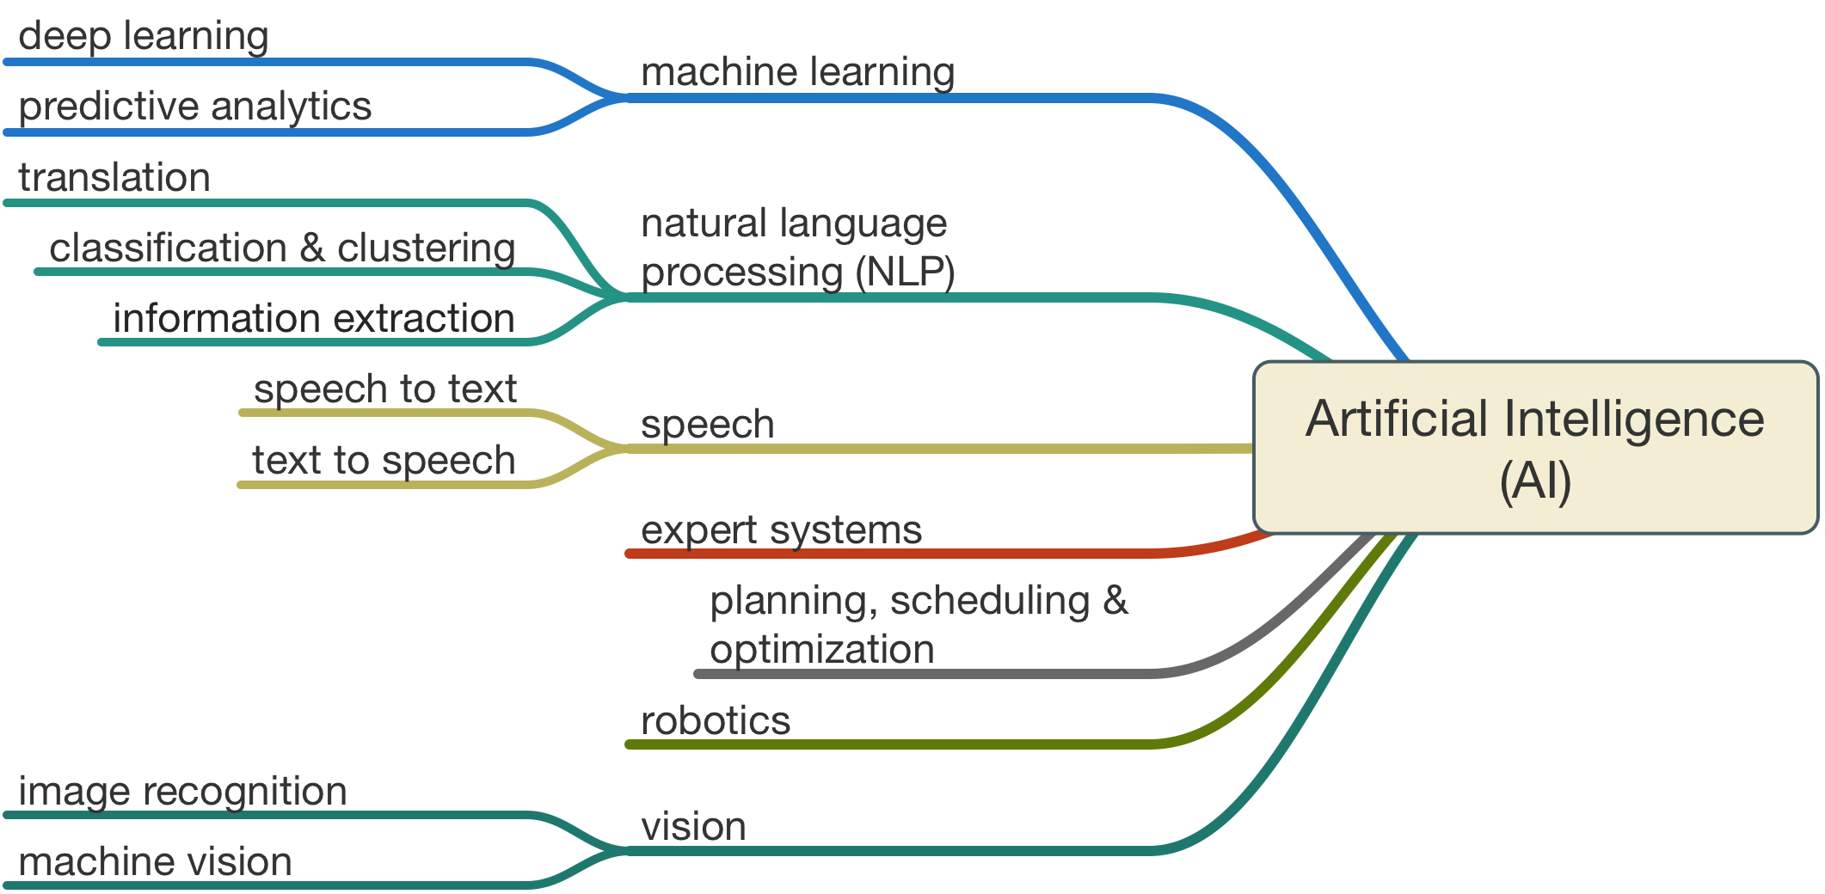
Artificial Intelligence - Summary
Source: http://www.legalexecutiveinstitute.com/artificial-intelligence-in-law-the-state-of-play-2016-part-1/

Slide 10
Cases

Slide 11

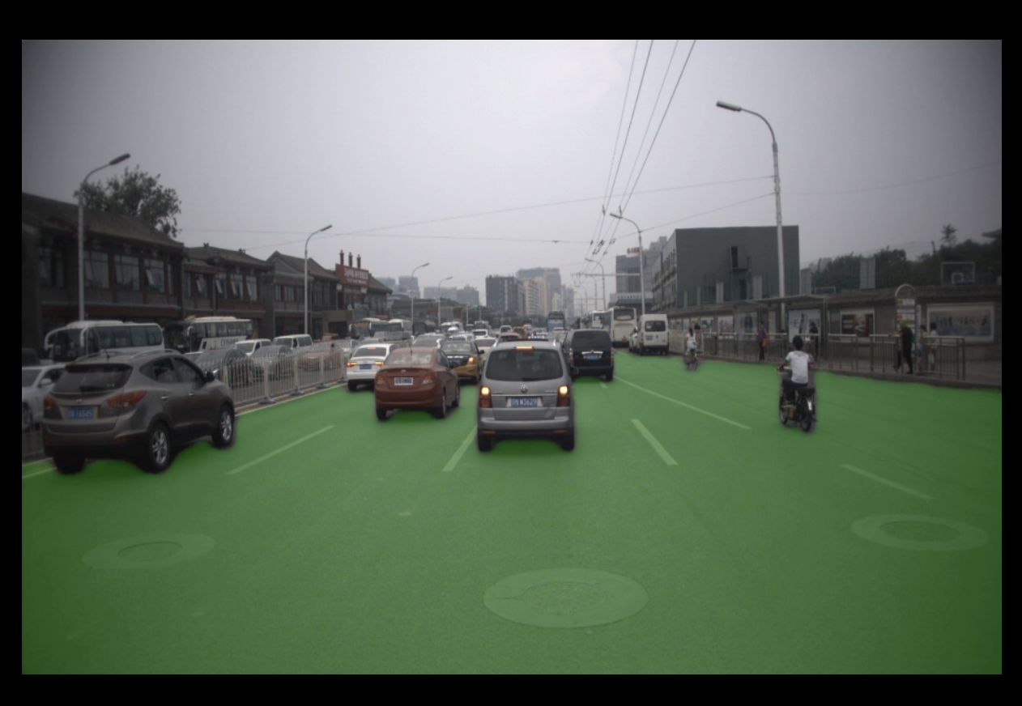
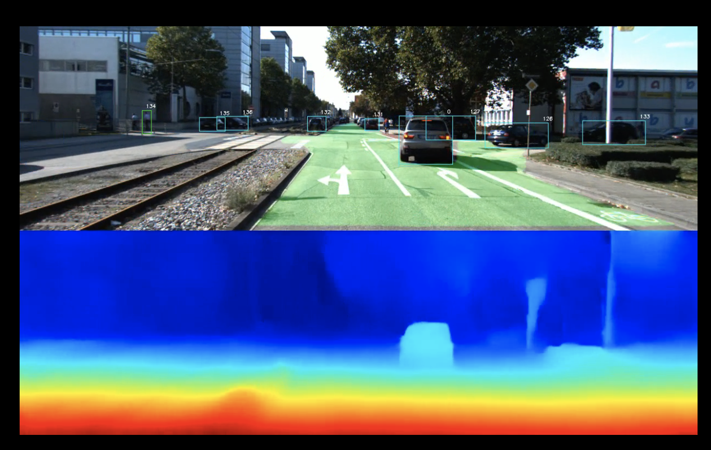
Autonomous cars
Real time per pixel
image segmentation
Centimeter-accurate positioning

Slide 12
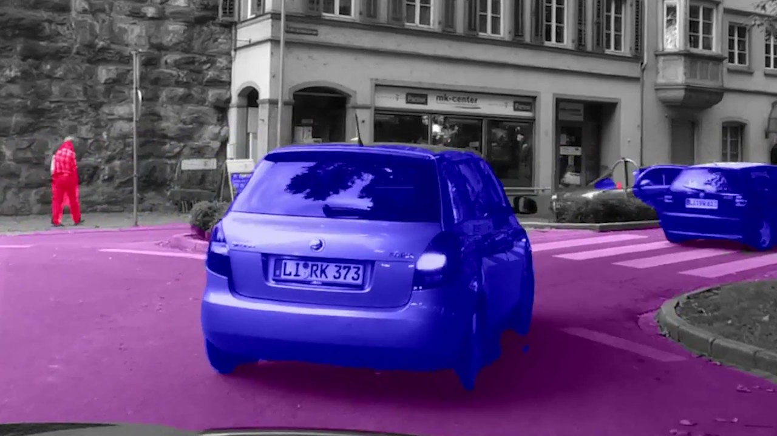
Image Segmentation
Source: https://github.com/msracver/FCIS

Slide 13

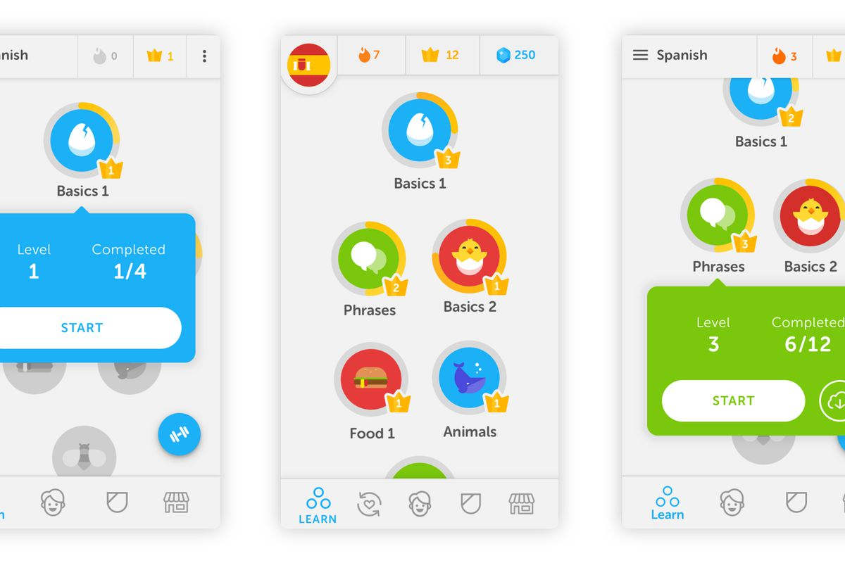
Text to speech

Slide 14


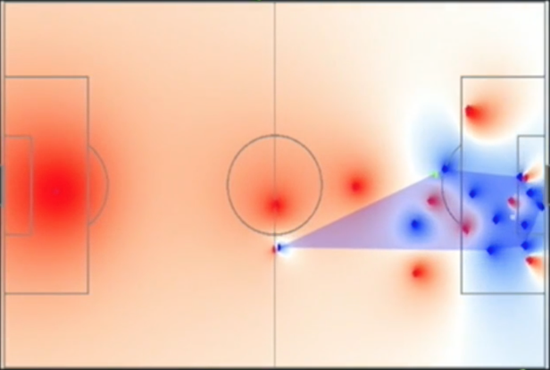
Sport Analytics

Slide 15
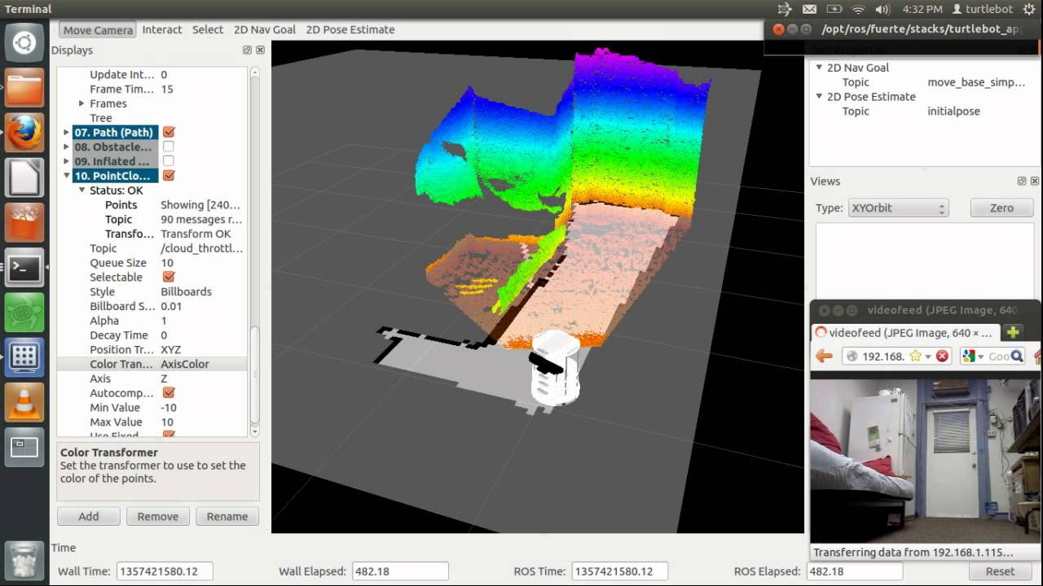
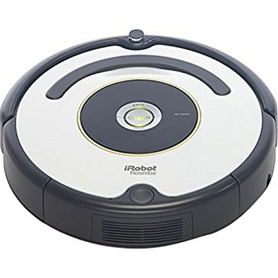
SLAM – Robot IoT
Source: https://www.youtube.com/watch?v=ynAjzHpw1XU

Slide 16

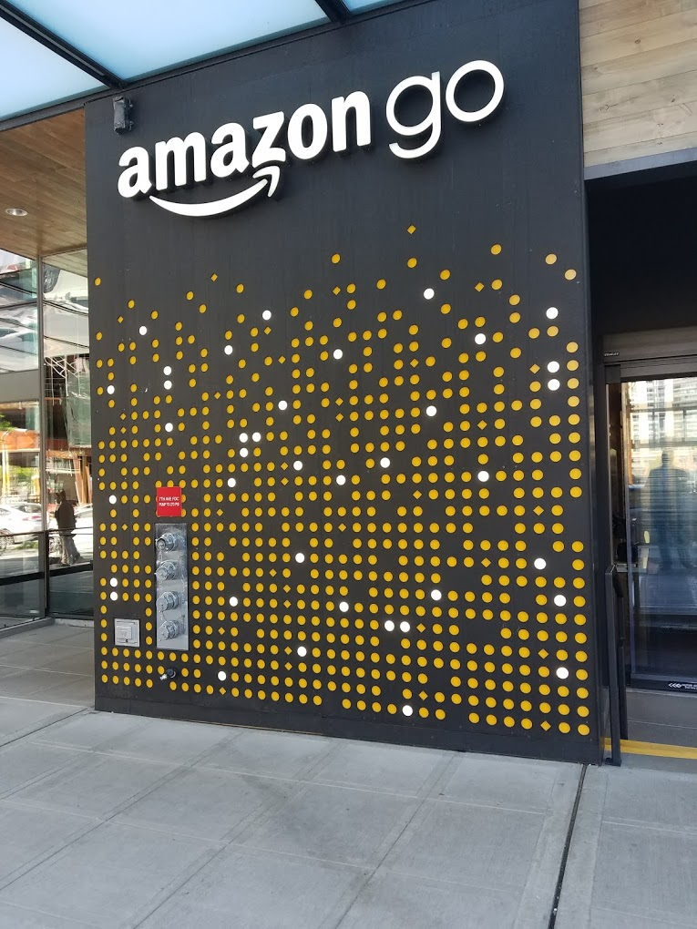
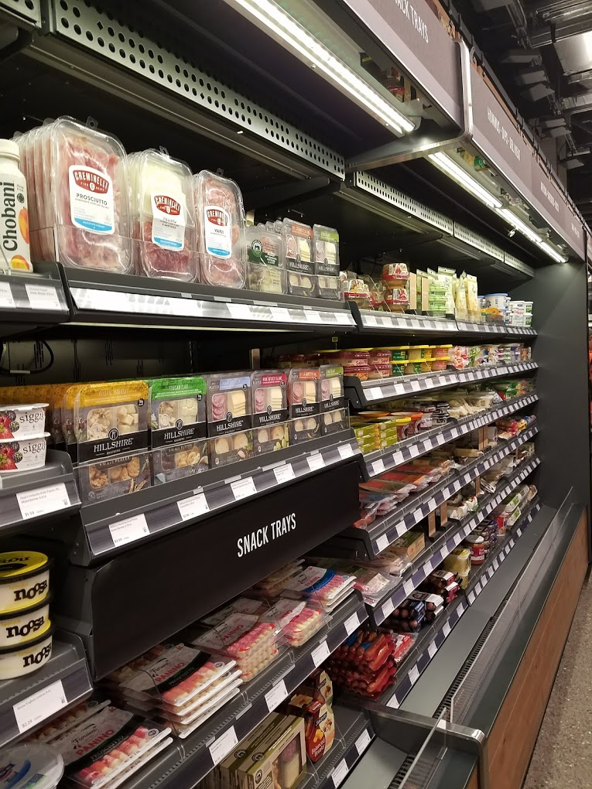

Frictionless Commerce

Slide 17

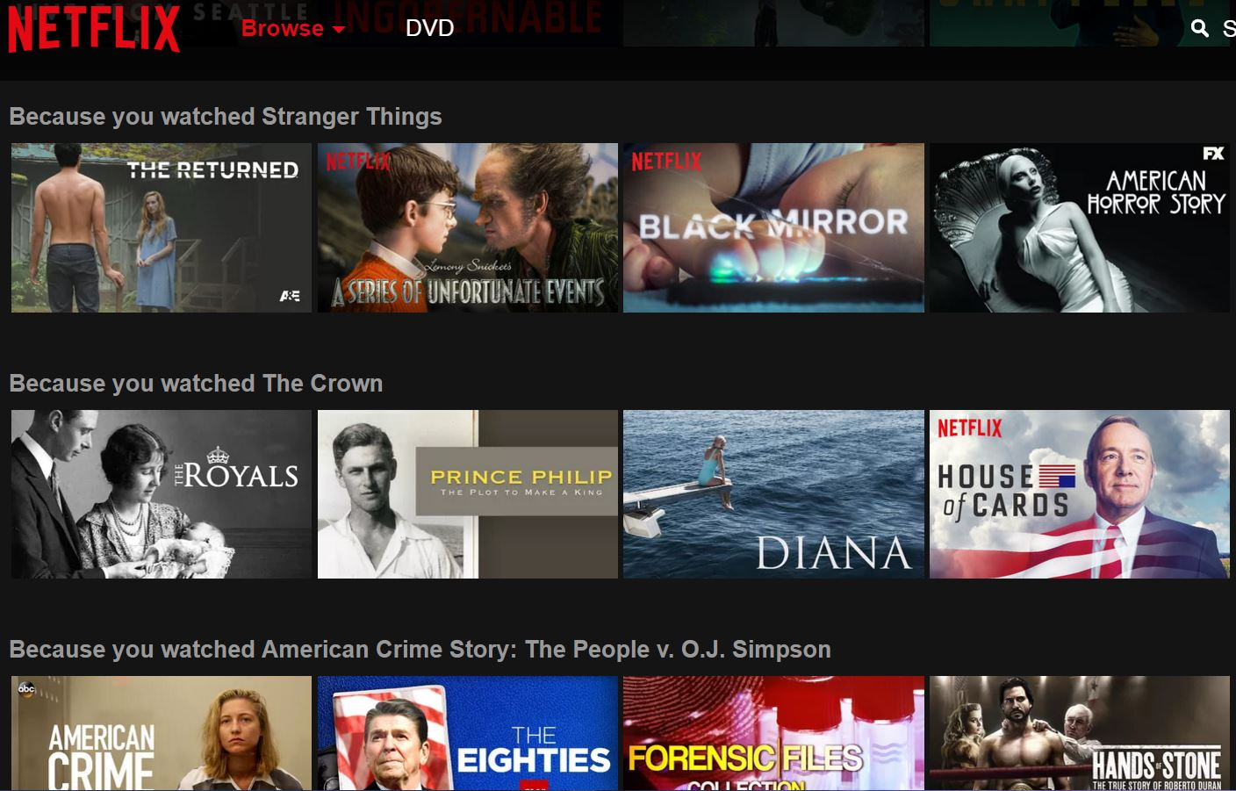
Personalized Recommendation/Ranking

Slide 18
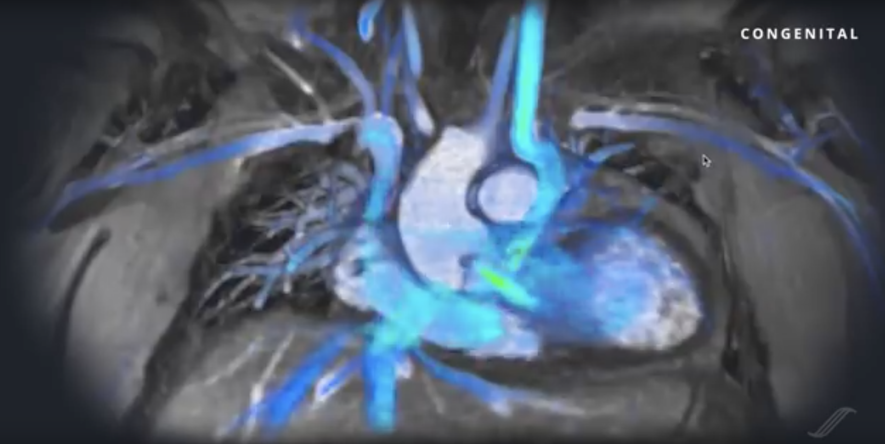
Medical Imaging

Slide 19
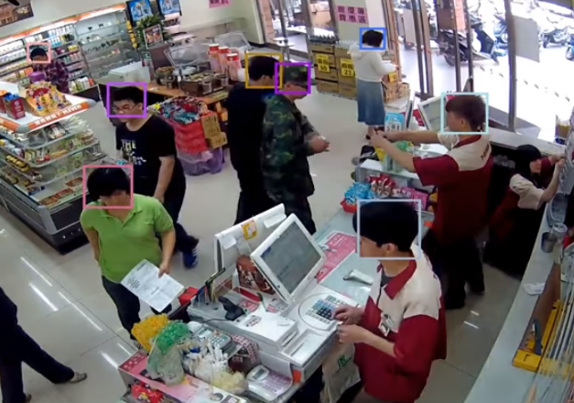
Consumer monitoring

Slide 20
Retail | Finance | Education | Healthcare
Predict demand trends | Automated personal finance | Automatic grading | Predict disease
Automate store & supply chain operations | Fraud detection | Personalize earning plans | Optimize hospital operations
Optimize pricing | Predict credit risk | Automate routine teacher tasks | Patient assistance agents
Personalization and Recommendations | Portfolio optimization | Plagiarism detection | Predict success rate of new drugs

Slide 21
AI at AWS ML, Lex, Polly, Rekognition, Rekognition Video, SageMaker, Comprehend, Transcribe, Translate, DeepLens, MXNet, etc

Slide 22
IA @AWS
Vision:
Rekognition
Rekognition Video
Speech:
Polly
Transcribe
Language:
Lex
Translate
Comprehend
Application
Services
Platform
Services
Amazon Machine Learning
Spark & EMR
Mechanical Turk
SageMaker
AWS Deep Learning AMI (Ubuntu & Amazon Linux – Cuda 8 & 9)
TensorFlow
Apache MXNet
CNTK
Caffe2 & Caffe
PyTorch
Keras
Gluon
Frameworks
& Infrastructure
GPU
(P2 & P3)
CPU
IoT (Greengrass)
Mobile
DeepLens

Slide 23
GPU?

Slide 24
Instances
G3: graphical applications
P2 & P3: high computational processing

Slide 25
Instances P2 & P3
Name | GPUs | vCPUs | RAM (GiB) | Network Bandwidth
p2.xlarge | 1 | 4 | 61 | High
p2.8xlarge | 8 | 32 | 488 | 10 Gbps
p2.16xlarge | 16 | 64 | 732 | 25 Gbps
p3.2xlarge | 1 | 8 | 61 | 10 Gbps
p3.8xlarge | 4 | 32 | 244 | 10 Gbps
p3.16xlarge | 8 | 64 | 488 | 25 Gbps
P2
Nvidia Tesla K80
Peering by GPUDirect
70 TeraFlops
P3
Nvidia Tesla V100
Peering by NVLink
1 PetaFlops
14x better than P2

Slide 26

Amazon Rekognition + Rekognition Video
Image recognition based on Deep Learning
Object and scene detection
Image moderation
Facial analysis
Celebrity recognition
Face comparison
Text in image
Video Analysis

Slide 27

Amazon Polly
Converts text to speech
Offers 47 voices in 25 languages
Low latency for developing real time applications
Latest features: Change Timbre, Breath

Slide 28

Amazon Lex
Build conversational interfaces using voice and text

Slide 29
Amazon Transcribe
An automatic speech recognition (ASR) service that makes it easy for developers to add speech to text capability to their applications
→ Supported languages: US English and Spanish
…more languages will come in as soon as possible after launch…

Slide 30
Amazon Translate
Amazon Translate is a Neural Machine Translation (MT) service for translating text (to and from English). Powered by deep learning.
Supported languages: Arabic, Chinese (Simplified), Chinese (Traditional), Czech, French, German, Italian, Japanese, Portuguese, Russian, Spanish, and Turkish.
Six additional languages will be supported in the coming months: Danish, Dutch, Finnish, Hebrew, Polish, and Swedish

Slide 31
Amazon Comprehend
Amazon Comprehend is a natural language processing (NLP) service that uses machine learning to find meaning and insights in text.
Supported languages: US English and Spanish

Slide 32
Amazon Comprehend
Identify the language of the text;
Extract entities:
Data, Location, Organization or Person;
Extract key phrases:
Places, People, Brands or Events;
Understand sentiment about products or services:
Positive, Negative, Neutral, or Mixed
Identify the main topics from a library of documents;
Clustering documents

Slide 33
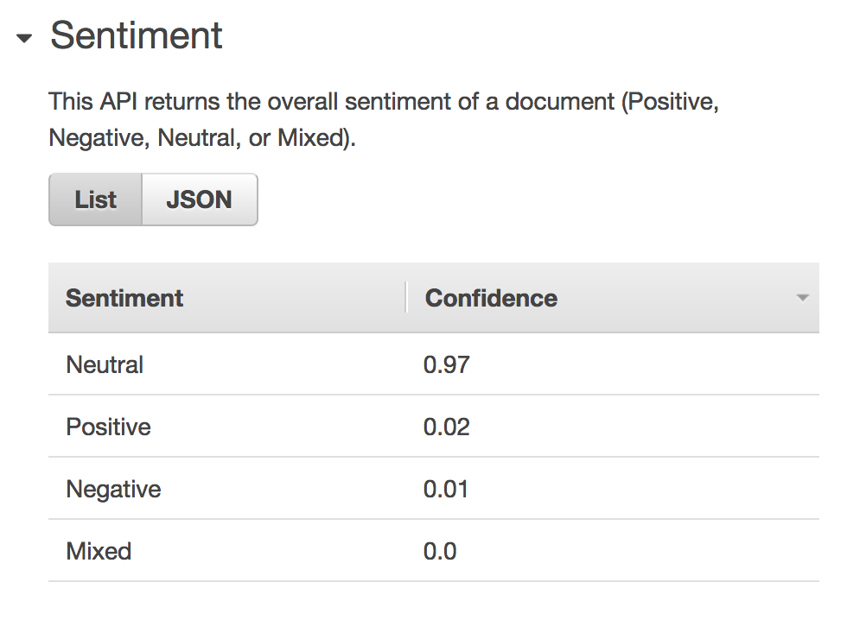
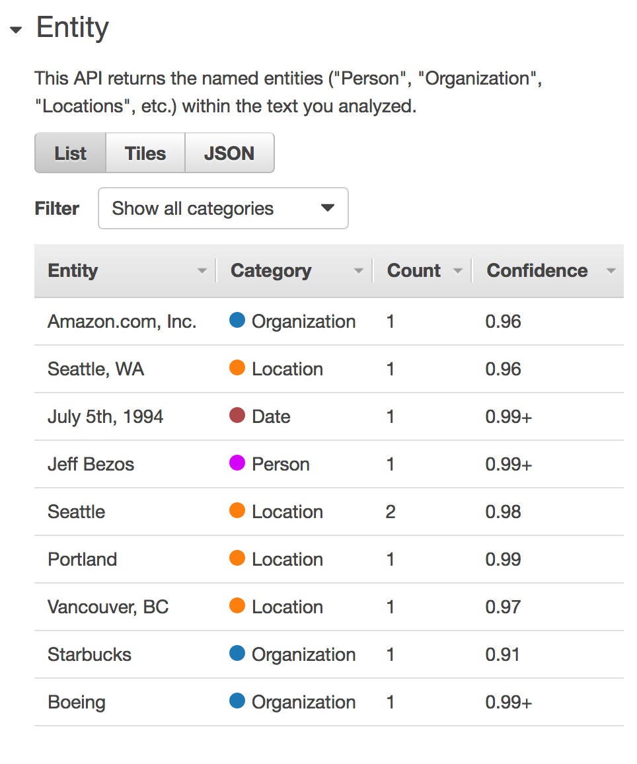
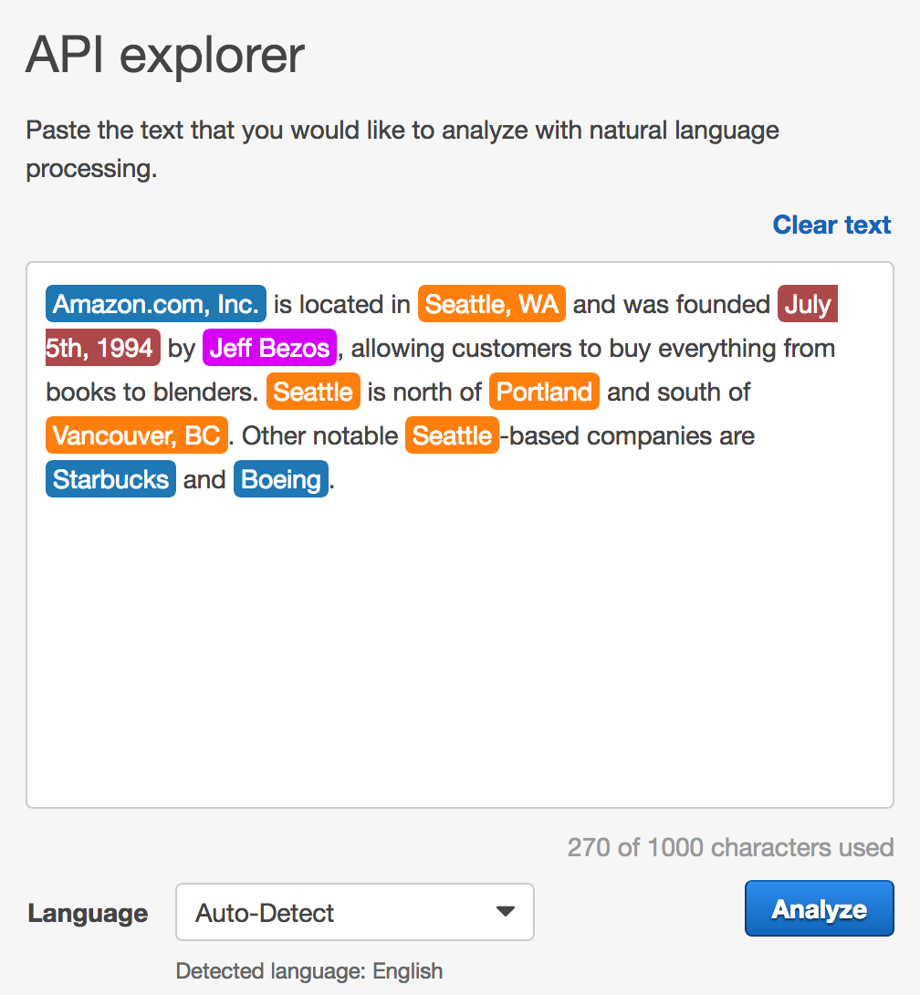
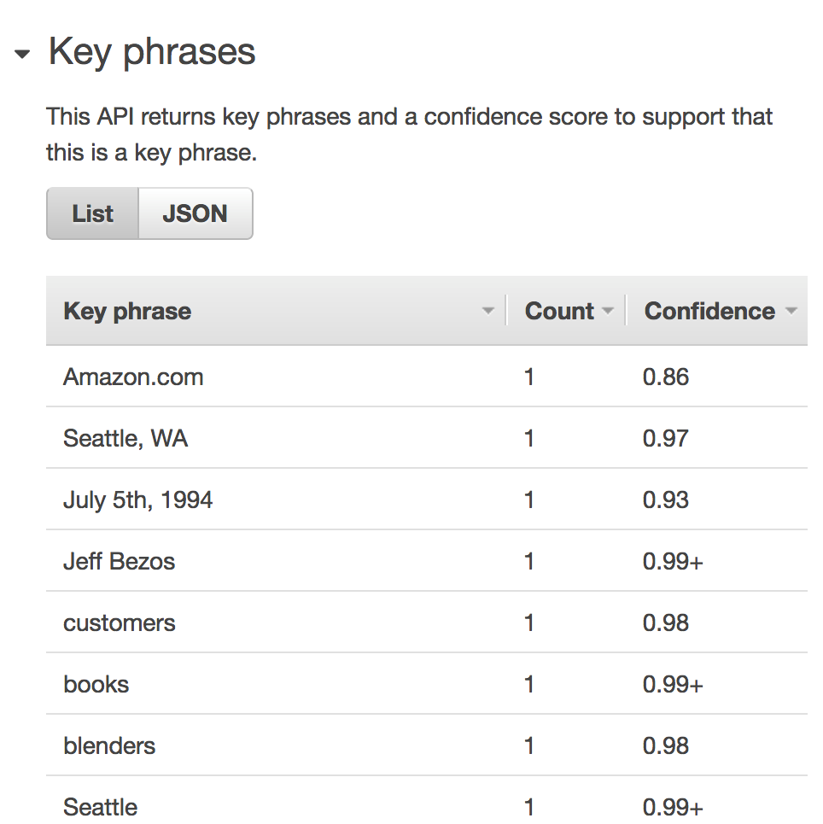
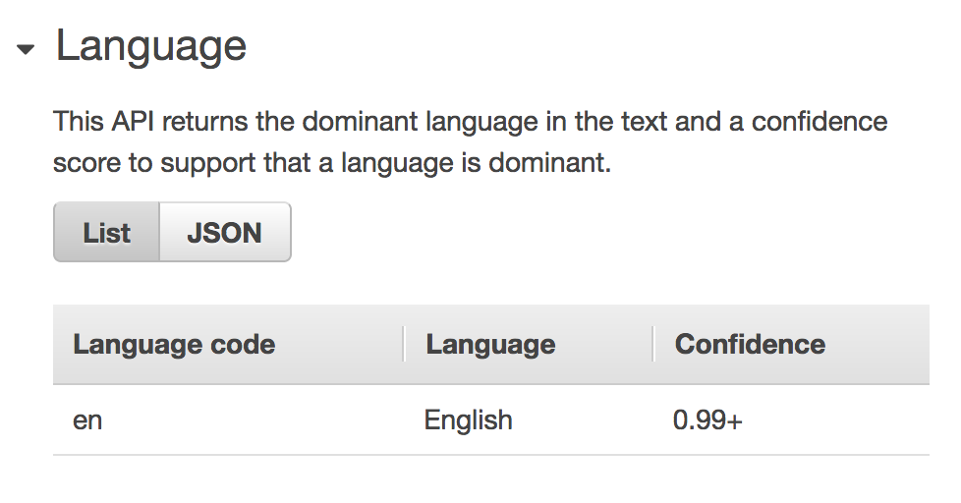
Amazon Comprehend

Slide 34
Demo-time

Slide 35


Putting all together #1 – Creating subtitles
Amazon Kinesis Video
Amazon
Transcribe
Movie Streaming
(language English)
Player
Amazon
Translate
Subtitles
Text from audio

Slide 36

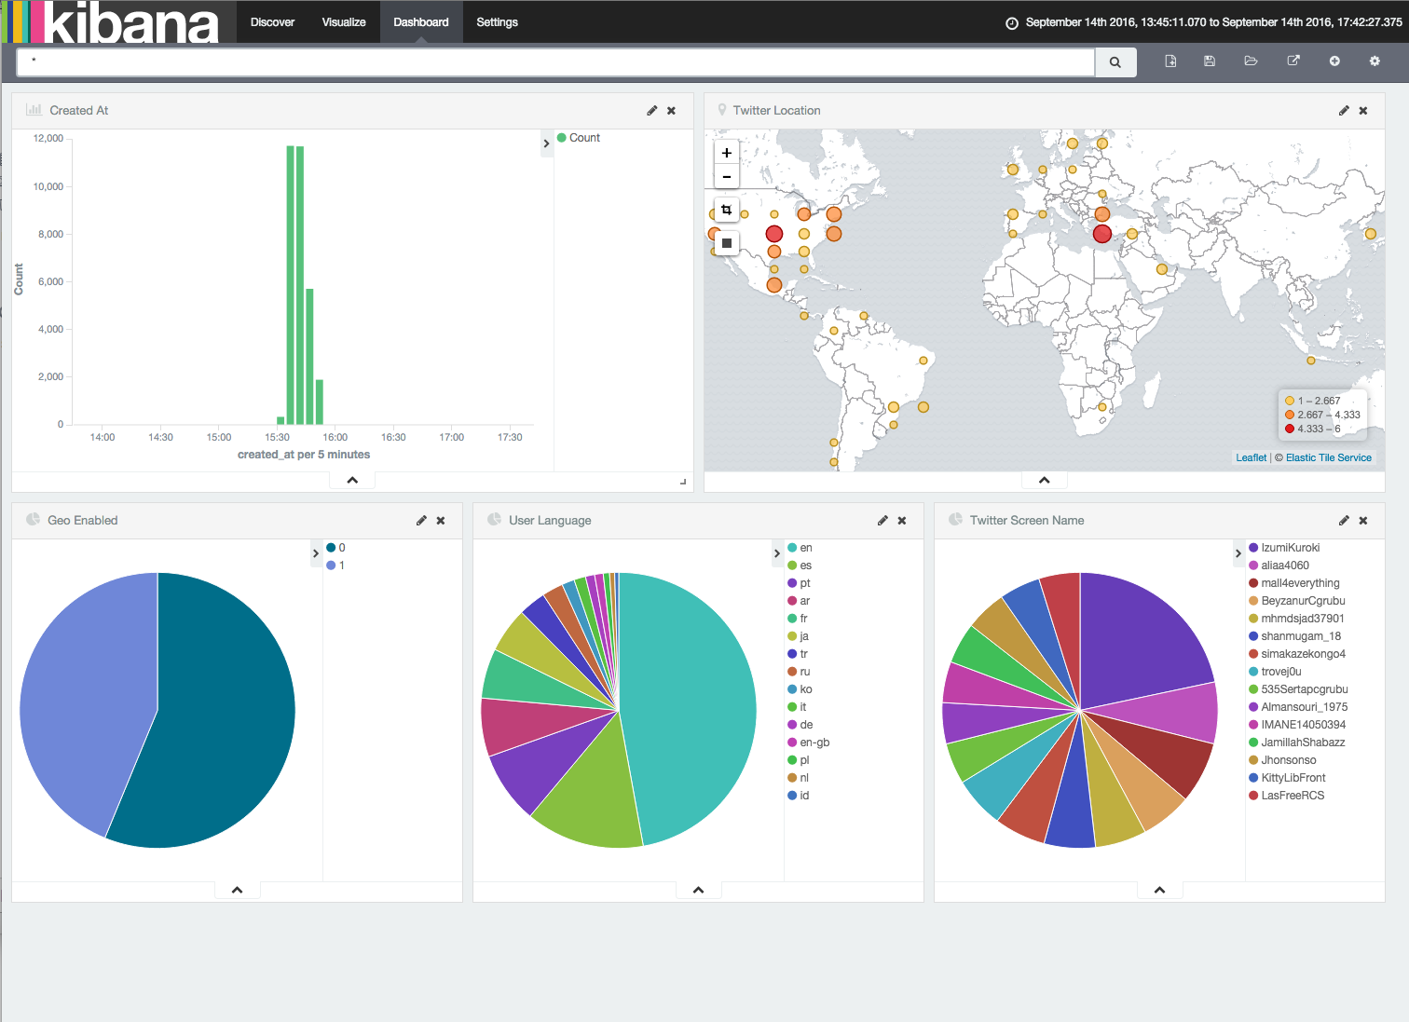

Putting all together #2 - Cognitive Discovery Application
Amazon
Translate
Text library
(English)
Documents
(portuguese)
Amazon
Comprehend
Index & Search

Slide 37
Amazon DeepLens
AWS DeepLens is the world’s first deep-learning enabled video camera for developers of all skill levels to grow their machine learning skills through hands-on computer vision tutorials, example code, and pre-built models.
→ Currently AWS DeepLens is only available in the US.

Slide 38
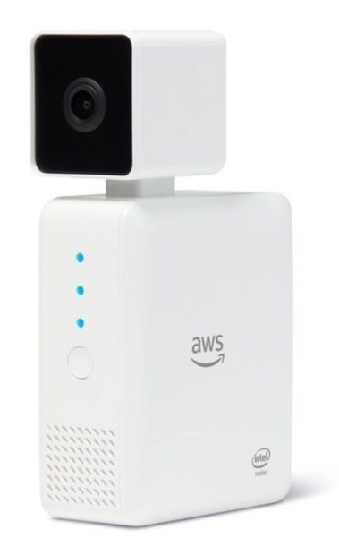
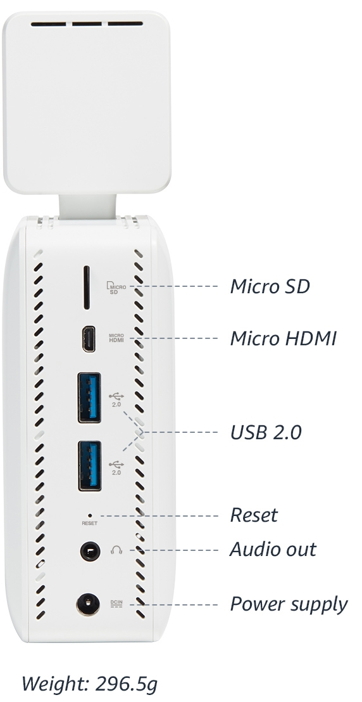
Amazon DeepLens
4MP camera with MJPEG
H.264 encoding at 1080p resolution
CPU: Intel Atom® Processor
GPU: Gen9 graphics
106 GFLOPS performance
8GB RAM
16GB memory
Expandable storage via microSD card
Dual band Wi-Fi
2 USB ports
Micro HDMI
Audio out
Ubuntu OS 16.04 LTS

Slide 39
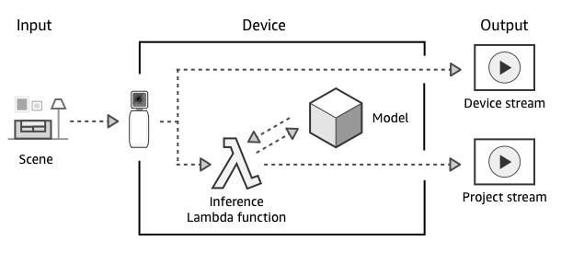
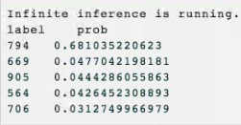
Amazon DeepLens
Greengrass ML Inference
Publish a model trained with Amazon SageMaker
Run it on a lambda, insider greengrass
Supported runtimes: Python 2.7, Node.JS 6.10, or Java 8)

Slide 40
Amazon SageMaker
Amazon SageMaker is a fully-managed machine learning service that enables data scientists and developers to quickly and easily build, train, and deploy machine learning models.
Hosted Jupyter notebooks
Model training
Model hosting (deploy in production – Endpoint)
Automatically scales
Performance metrics to Amazon CloudWatch Metrics
Docker based images

Slide 41
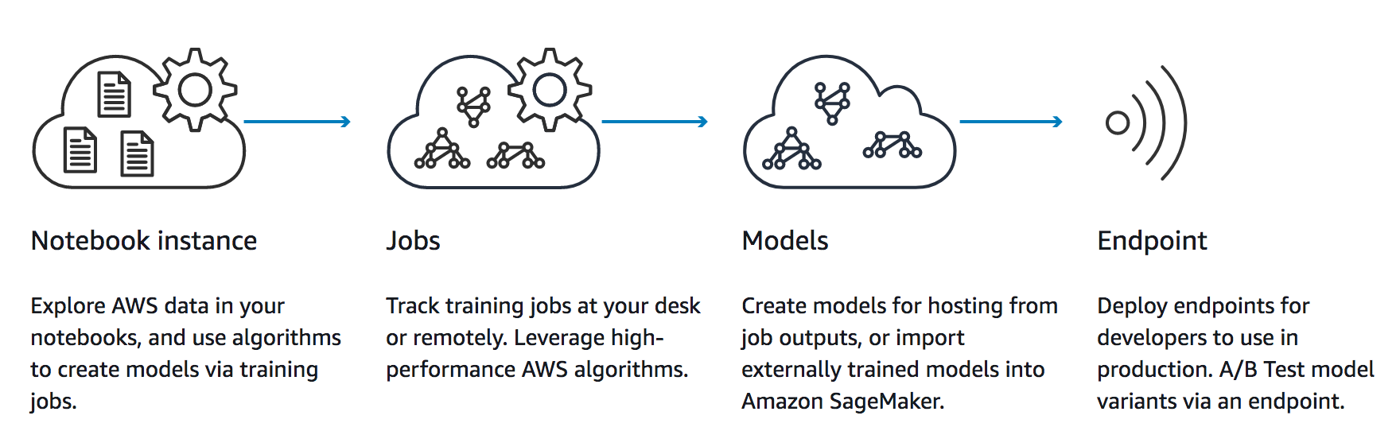
Amazon SageMaker – Development pipeline

Slide 42
Amazon SageMaker – Predicting with Python
import boto3
from sagemaker.predictor import json_serializer, json_deserializer
sm = boto3.client('sagemaker-runtime')
response = sm.invoke_endpoint(
EndpointName='sagemaker-mxnet-py2-gpu-2017-12-06-18-31-17-921',
Body=json_serializer( image_data[1] )
)
resp = json_deserializer(response['Body'], response['ContentType'])

Slide 43




Amazon ML Solutions Lab https://aws.amazon.com/ml-solutions-lab/ml-solutions-lab-faqs/
Brainstorming
Custom Modeling
On-site with
Amazon Experts
Training

Slide 44



AWS Academy
Ready to Teach
Institutions and educators receive a complete curriculum, designed to be easily integrated into existing education programs.
Maintained by AWS
Curriculum content is created and updated by AWS, saving educators time so they can focus on their students.
Instructor Accreditation
Member educators receive complimentary AWS training and discounts for AWS Certification as part of instructor accreditation.

Slide 45


AWS Academy
https://aws.amazon.com/education/awsacademy/

Slide 46
Some theory to start from
Machine Learning cheatsheets
https://github.com/afshinea/stanford-cs-229-machine-learning
An Introduction to Statistical Learning
https://www-bcf.usc.edu/~gareth/ISL/
Deep Learning with Python, Francois Chollet
https://github.com/veritone/ds-transcription-capstone/blob/master/Deep%20Learning%20With%20Python%20Chollet.pdf
Python Data Science Handbook, Jake VanderPlas
https://tanthiamhuat.files.wordpress.com/2018/04/pythondatasciencehandbook.pdf

Slide 47
Thank you!
Oct, 2018
© 2017, Amazon Web Services, Inc. or its Affiliates. All rights reserved.

